Slide 1
PEC

Slide 2
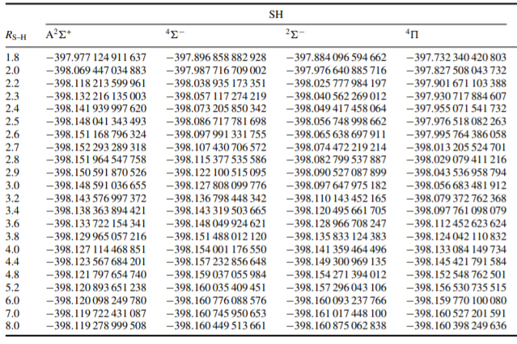
08BrHaHo

Slide 3
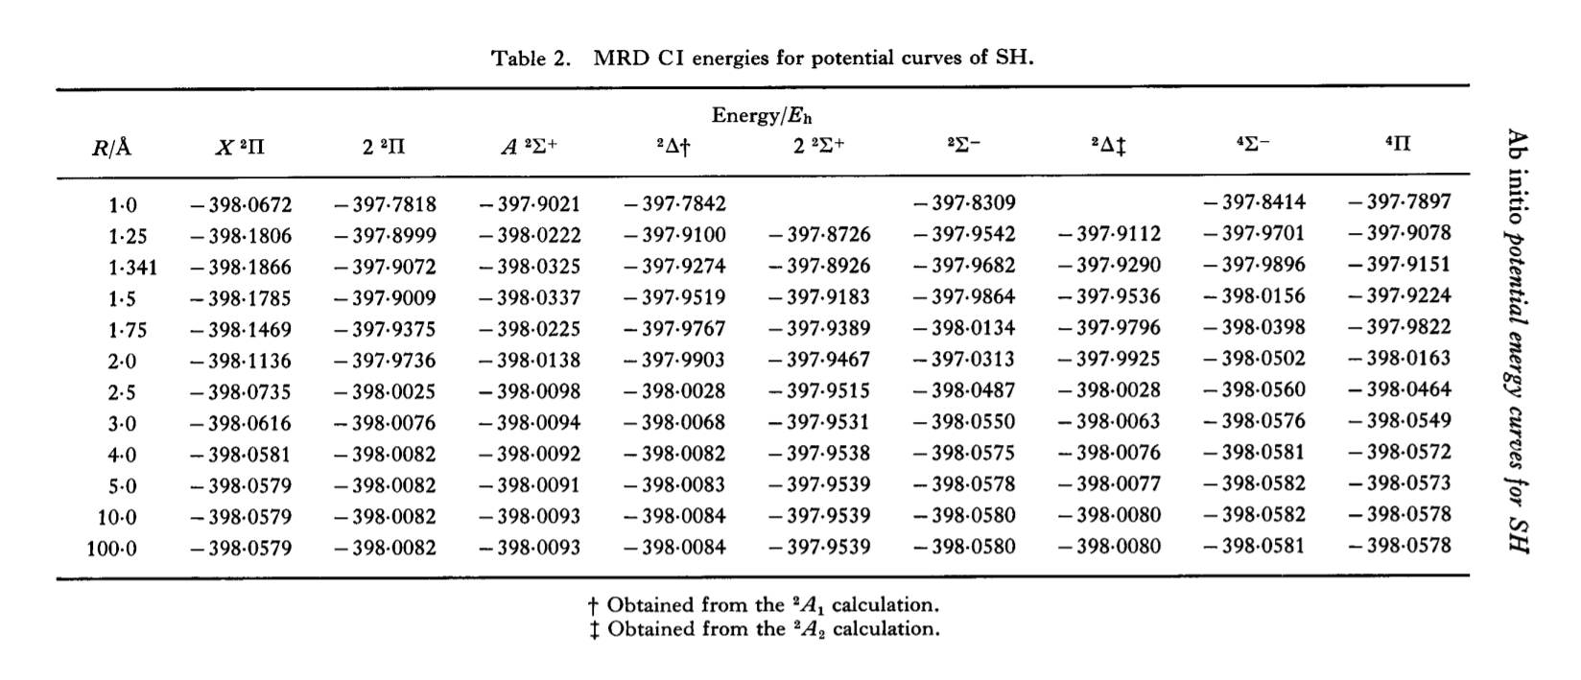
82HiGu

Slide 4
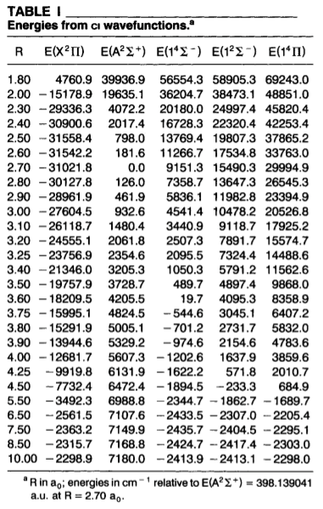
95Ma

Slide 5
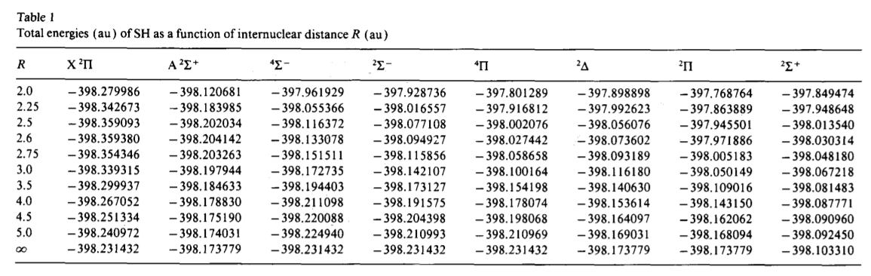
92PaSu

Slide 6
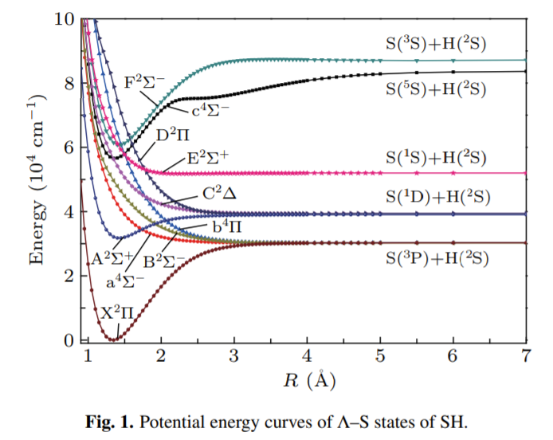
21ZhLiLiGu
Same units as in 19GoYuTe

Slide 7
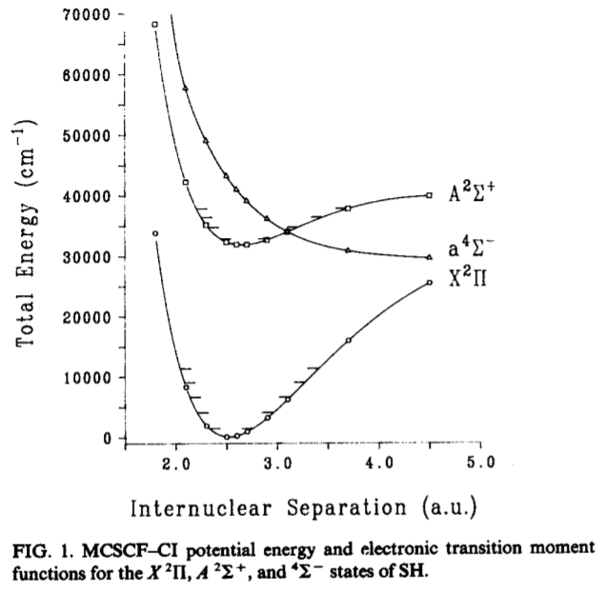
85SeWeRoRe

Slide 8
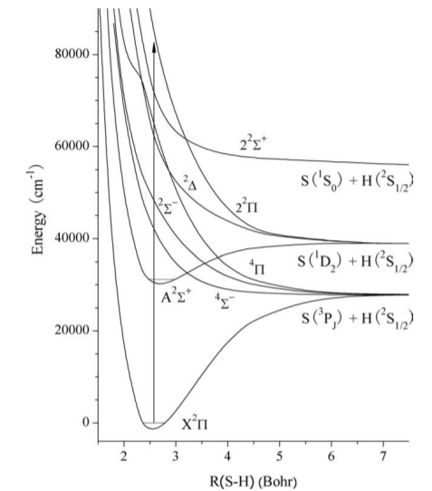
06ChZhZh

Slide 9
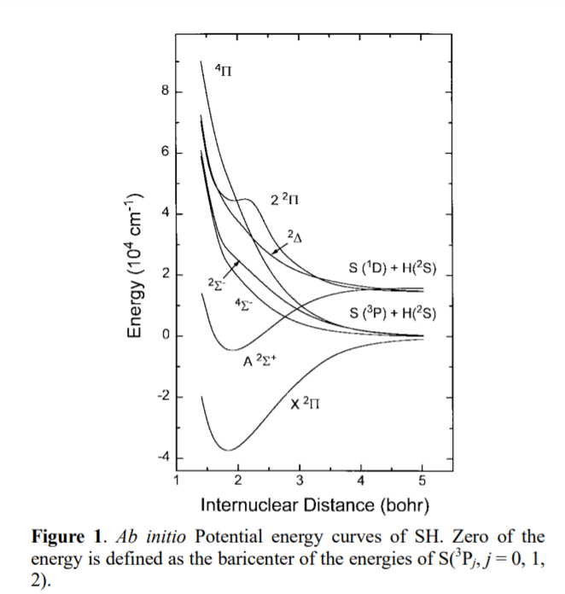
00Le

Slide 10
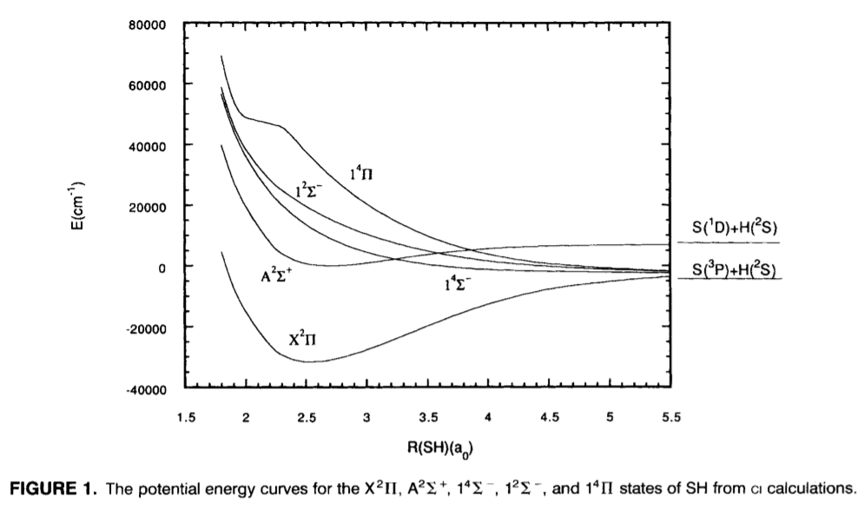
95Ma

Slide 11
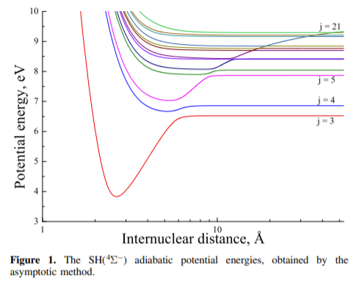
20BeVo

Slide 12
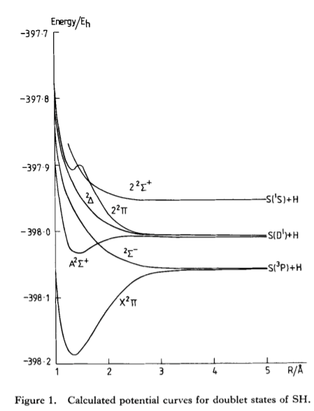
82HiGu

Slide 13
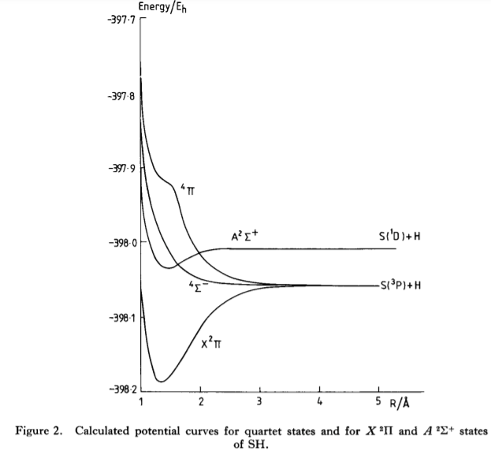
82HiGu

Slide 14
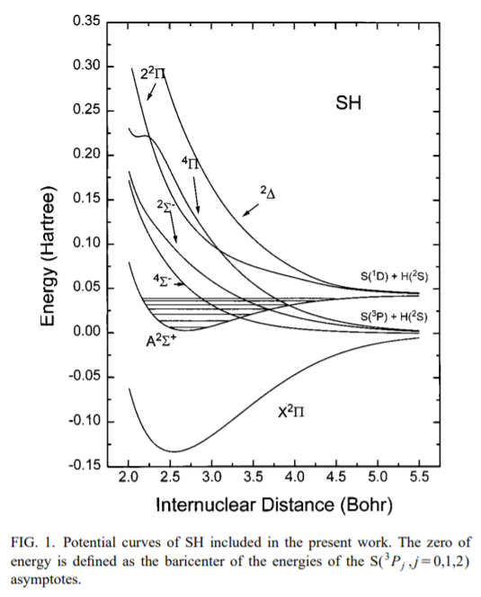
01LeSu

Slide 15
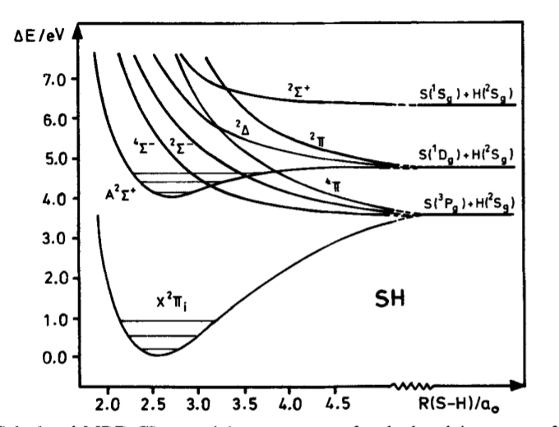
87BrHi

Slide 16
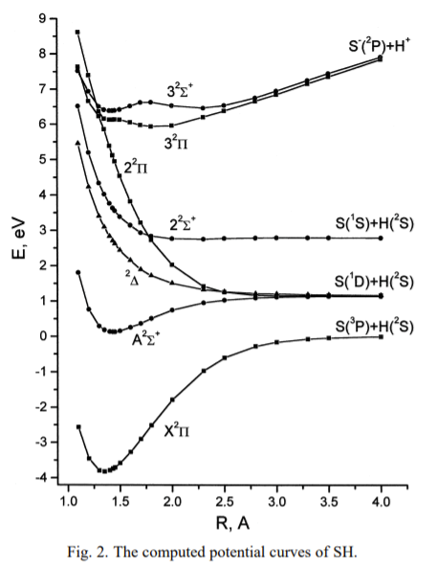
95Ma
Does not contain the three mentioned predissociative curves but contains higher lying states

Slide 17
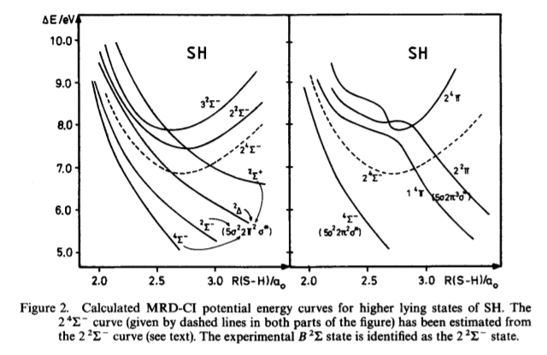
87BrHi
Partially contains mentioned predissociative curves but contains higher lying states

Slide 18
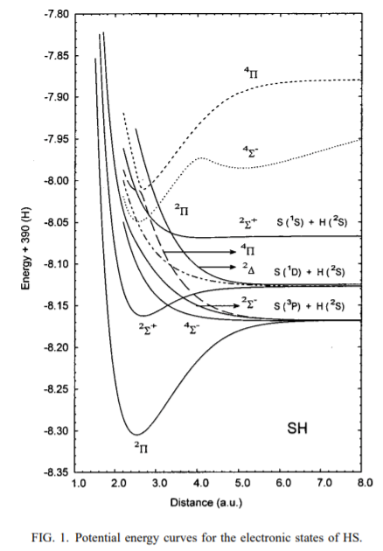
01ReOr

Slide 19
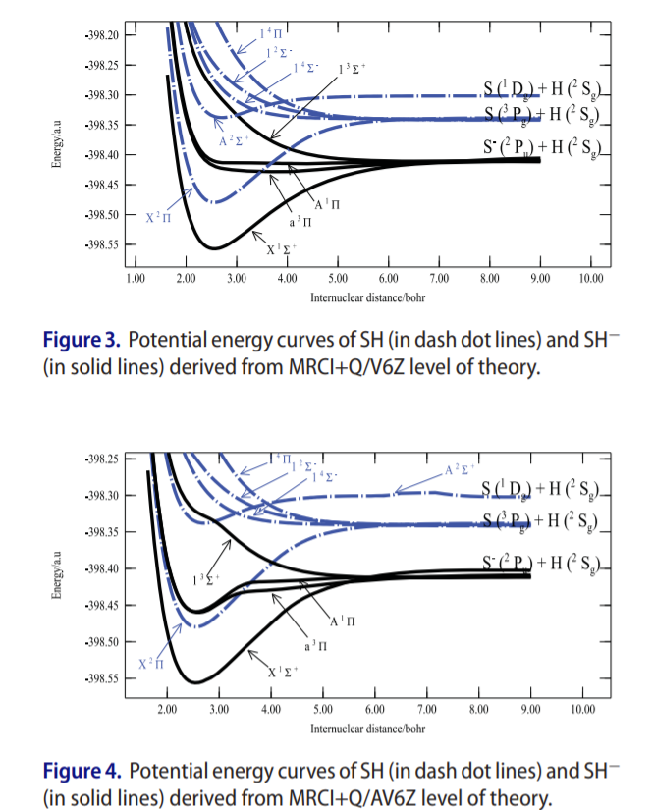
16VaNs

Slide 20
DMC

Slide 21
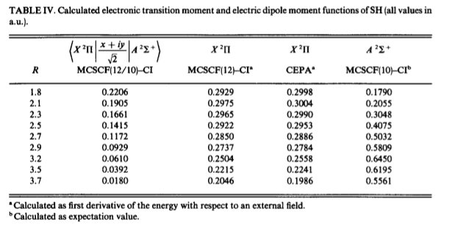
85SeWeRoRe

Slide 22
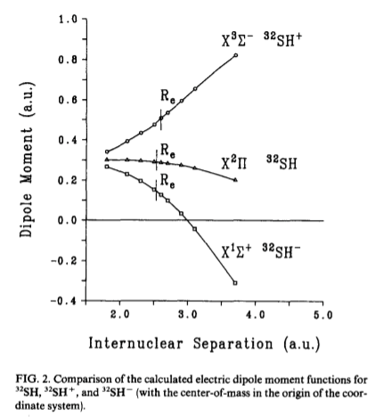
85SeWeRoRe

Slide 23
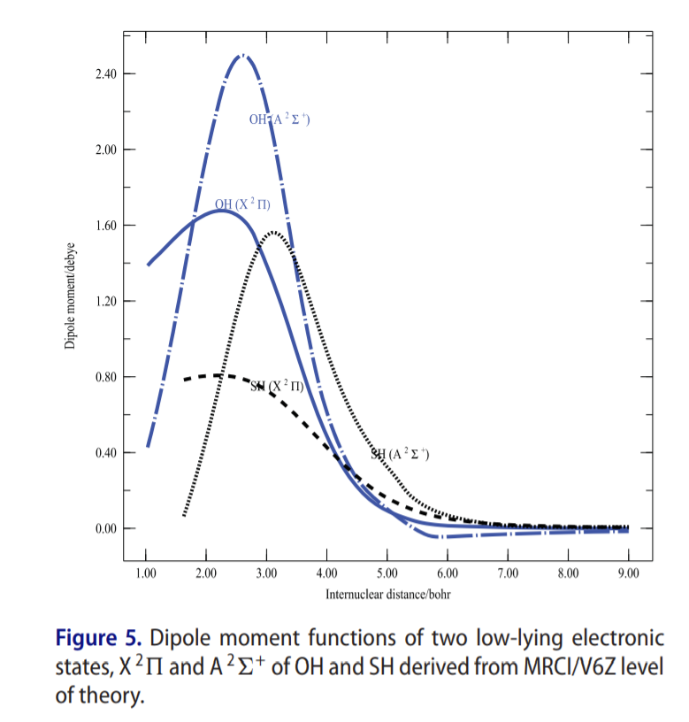
16VaNs

Slide 24
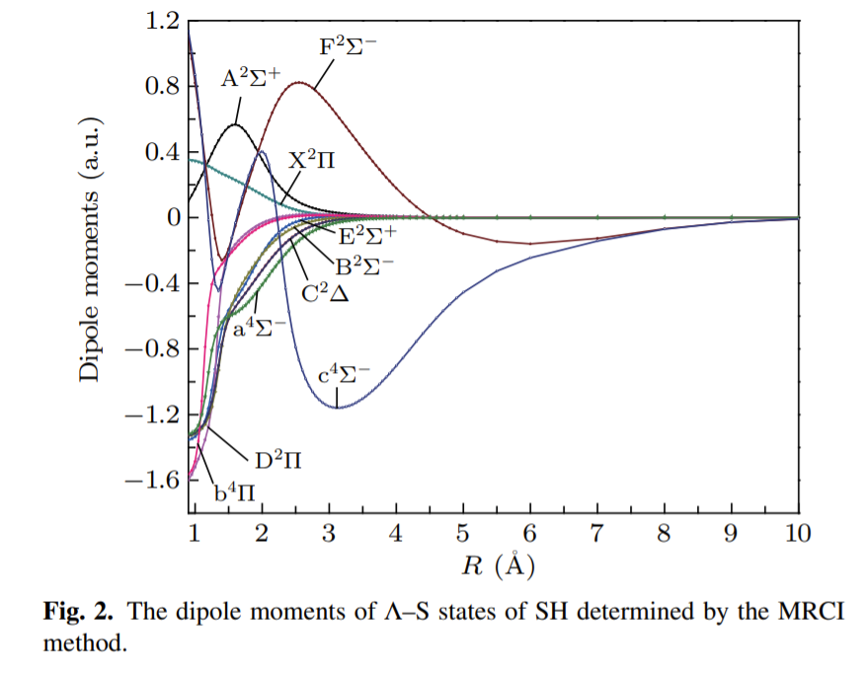
21ZhLiLiGu

Slide 25
SOC

Slide 26
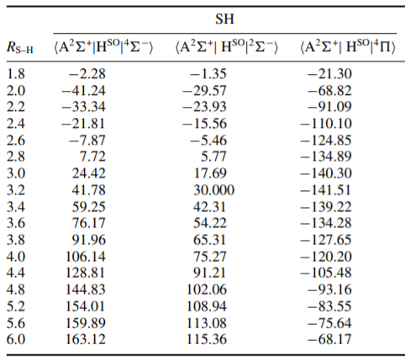
08BrHaHo

Slide 27
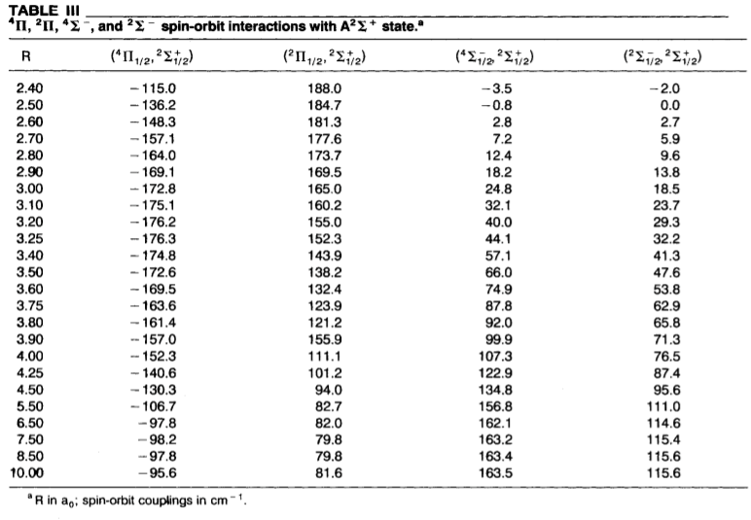
95Ma

Slide 28
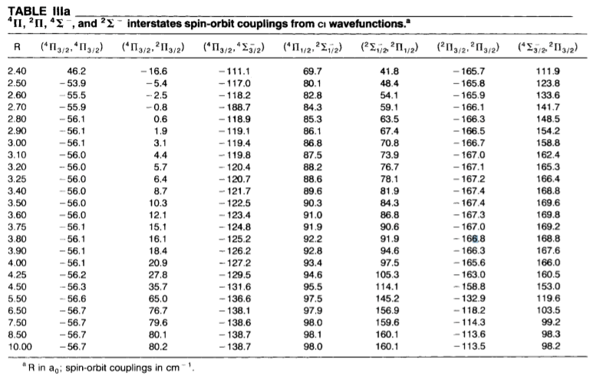
95Ma

Slide 29
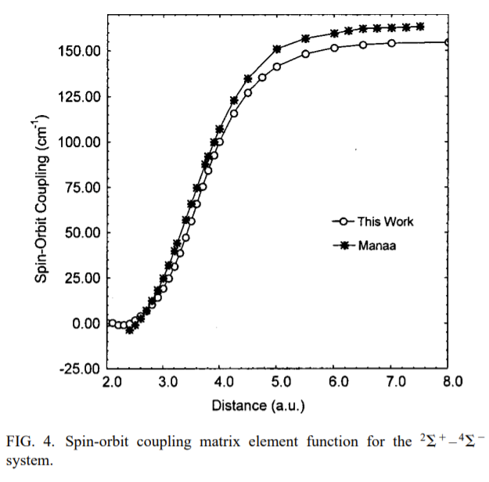
01ReOr

Slide 30
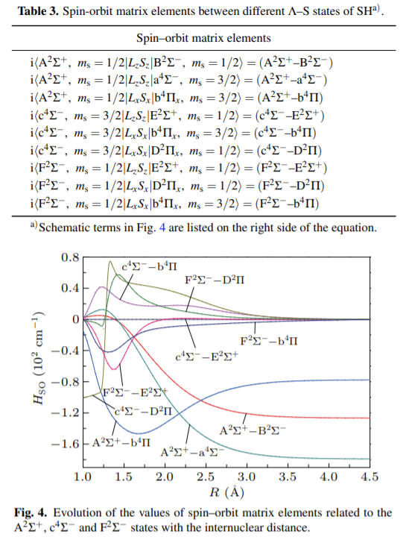
21ZhLiLiGu
Same units as 19GoYuTe

Slide 31
AMC

Slide 32
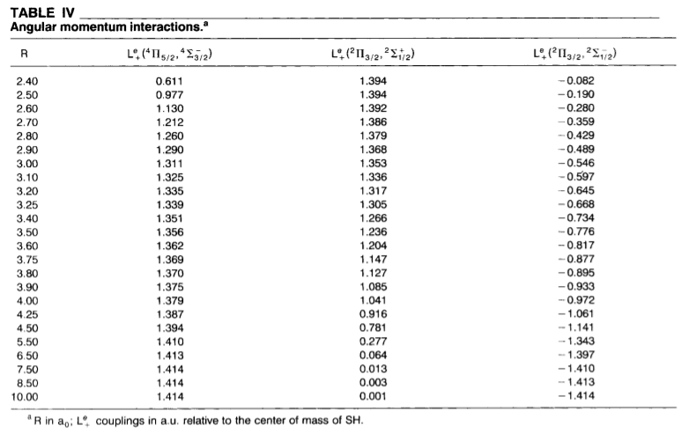
95Ma

